Slide 1




Slide 2

TEST TIME ON SEGMENTED AND INCREMENTAL SIEVE
URL:https://forms.gle/geq3XgXnt7WCk3qMA
QR CODE:

Slide 3

EULER’S PHI ALGORITHM

Slide 4
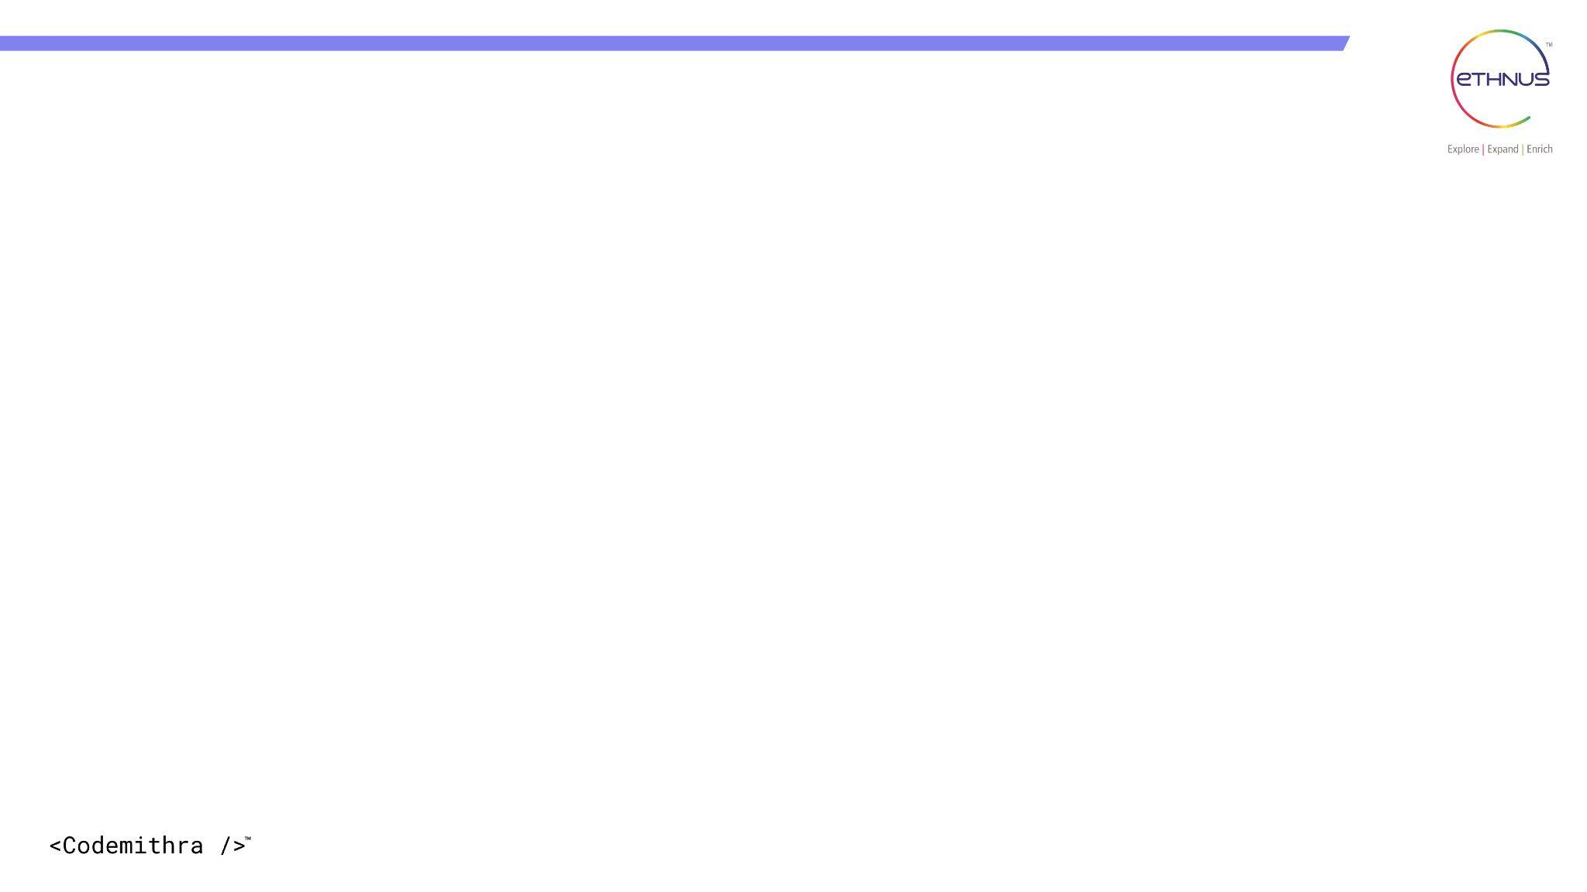

TOPICS
Introduction
Examples
Properties
Coding
Interview Questions

Slide 5
INTRODUCTION
Euler's totient function (also called phi-function or totient function) takes a single positive integer n as input and outputs the number of integers present between 1 and n that are co-prime to n.
Note:
2 positive integers a and b are said to be co-prime if their greatest common factor/divisor is equal to 1, that is,
gcd(a,b)=1
1 is considered co-prime to all numbers.

Slide 6

Example:1
Find Փ(5)
Solution
Here n=5
Numbers less than 5 are 1,2,3 and 4
Euler’s Phi Algorithm
GCD | Relatively Prime?
GCD(1,5)=1
GCD(2,5)=1
GCD(3,5)=1
GCD(4,5)=1
there are 4 numbers less than 5 that are co-prime to it
Therefore Փ(5)=4

Slide 7
Example:2
Find Փ(11)
Solution
Here n=11
Numbers less than 11 are 1,2,3,4,5,6,7,8,9 and 10
Euler’s Phi Algorithm
GCD | Relatively Prime?
GCD(1,11)=1
GCD(2,11)=1
GCD(3,11)=1
GCD(4,11)=1
GCD(5,11)=1
GCD | Relatively Prime?
GCD(6,11)=1
GCD(7,11)=1
GCD(8,11)=1
GCD(9,11)=1
GCD(10,11)=1
there are 10 numbers less than 11 that are co-prime to it
Therefore Փ(11)=10

Slide 8
Example:3
Find Փ(8)
Solution
Here n=8
Numbers less than 8 are 1,2,3,4,5,6 and 7
Euler’s Phi Algorithm
GCD | Relatively Prime?
GCD(1,8)=1
GCD(2,8)=2
GCD(3,8)=1
GCD(4,8)=4
GCD | Relatively Prime?
GCD(5,8)=1
GCD(6,8)=2
GCD(7,8)=1
there are 4 numbers less than 8 that are co-prime to it
Therefore Փ(8)=4

Slide 9

Properties
 | Criteria of 'n' | Formula
 | 'n' is prime. | Φ(n) = (n-1)
Φ(n) | n = p x q 'p' and 'q' are primes. | Φ(n) = (p-1) × (q-1)
 | n = a x b. Either 'a' or 'b’ is composite. Both 'a' and 'b' are composite.

Slide 10
Property 1
 | Criteria of 'n' | Formula
 | 'n' is prime. | Φ(n) = (n-1)
Φ(n)
Proof
Find Φ(7)
Here n=7
‘n’ is a prime number
Φ(n) = (n-1)
Φ(7) = (7-1)
Φ(7) = 6
there are 6 numbers less than 7 that are co-prime to it
Therefore Փ(7)=6

Slide 11
Property 2
 | Criteria of 'n' | Formula
Φ(n) | n = p x q 'p' and 'q' are primes. | Φ(n) = (p-1) × (q-1)
Proof
Find Φ(35)
Here n=35
‘n’ is a product of two prime numbers 5 and 7
Let us assign p=5 and q=7.
Φ(n)=(p-1) × (q-1)
Φ(35)=(5-1) × (7-1)
= 4 x 6
= 24
So, there are 24 numbers that are lesser than 35 and relatively prime to 35.
Therefore Փ(35)=24

Slide 12
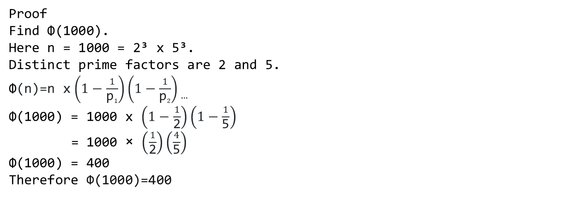
Property 3
 | Criteria of 'n' | Formula
Φ(n) | n = a x b. Either 'a' or 'b’ is composite. Both 'a' and 'b' are composite.

Slide 13
Basic Algorithm
A simple solution is to iterate through all numbers from 1 to n-1 and count numbers with gcd with n
import java.io.*; class Main { // Function to return GCD of a and b static int gcd(int a, int b) { if (a == 0) return b; return gcd(b % a, a); } static int phi(int n) { int result = 1; for (int i = 2; i < n; i++) | if (gcd(i, n) == 1) result++; return result; } public static void main(String[] args) { int n=5; //Finding Phi for input n System.out.println(phi(n)); } }
Time Complexity: O(N log N)

Slide 14
Better Solution
Algorithm
1) Initialize: result = n
2) Run a loop from 'p' = 2 to sqrt(n), do following for every 'p'.
a) If p divides n, then
Set: result = result * (1.0 - (1.0 / (float) p));
Divide all occurrences of p in n.
3) Return the result

Slide 15
import java.io.*;
class Main {
static int phi(int n) {
float result = n;
for (int p = 2; p * p <= n; ++p) {
if (n % p == 0) {
while (n % p == 0)
n /= p;
result *= (1.0 - (1.0 / (float) p));
}
}
if (n > 1)
result -= result / n;
return (int) result;
}
public static void main(String args[]) {
int n = 35;
System.out.println("phi(" + n + ") = " + phi(n));
}
}

Slide 16
Better Solution - 2
We can avoid floating-point calculations in the above method. The idea is to count all prime factors and their multiples and subtract this count from n to get the totient function value (Prime factors and multiples of prime factors won’t have GCD as 1)
Algorithm
1) Initialize result as n
2) Consider every number 'p' (where 'p' varies from 2 to Φn).
If p divides n, then do following
a) Subtract all multiples of p from 1 to n [all multiples of p will have gcd more than 1 (at least p) with n]
b) Update n by repeatedly dividing it by p.
3) If the reduced n is more than 1, then remove all multiples of n from result.

Slide 17
Program
import java.io.*;
class Main
{
static int phi(int n)
{
int result = n;
for (int p = 2; p * p <= n; ++p)
{
if (n % p == 0)
{
while (n % p == 0)
n /= p;
result -= result / p;
}}
if (n > 1)
result -= result / n;
return result;
}
public static void main (String[] args)
{
int n=1000;
System.out.println(phi(n));
}
}

Slide 18
INTERVIEW QUESTIONS

Slide 19
Interview questions
Interview questions
What is Euler's Phi algorithm?
Answer: Euler's Phi algorithm is a mathematical algorithm used to calculate the totient function of a given number. The totient function (φ(n)) is the number of positive integers less than or equal to n that are relatively prime to n.

Slide 20
Interview questions
Interview questions
What is the time complexity of Euler's Phi algorithm?
Answer: The time complexity of Euler's Phi algorithm is O(sqrt(n) log n), where n is the input number.

Slide 21
Interview questions
Interview questions
What are some applications of Euler's Phi algorithm?
Answer: Euler's Phi algorithm has several applications in number theory and cryptography. It is used in RSA encryption and decryption, as well as in the generation of keys for public key cryptography. It is also used in determining the order of an element in a group, and in solving the discrete logarithm problem.

Slide 22
Interview questions
Interview questions
Can Euler's Phi algorithm be used for large numbers?
Answer: Euler's Phi algorithm can be used for large numbers, but it may become computationally expensive due to the prime factorization step. In some cases, it may be necessary to use more advanced algorithms for calculating the totient function of very large numbers.

Slide 23
Interview questions
Interview questions
What is the significance of Euler's Phi function?
Answer: Euler's Phi function is significant in number theory and cryptography as it is used in many mathematical proofs and algorithms. It has applications in determining the relative primality of two numbers, generating RSA keys, and solving the discrete logarithm problem, among other things.

Slide 24
Interview questions
How does Euler's Phi algorithm differ from the Sieve of Eratosthenes?
Answer: Euler's Phi algorithm and the Sieve of Eratosthenes are two different algorithms used in number theory. The Sieve of Eratosthenes is used to find all the prime numbers up to a given limit, while Euler's Phi algorithm is used to calculate the totient function of a given number. The two algorithms have different purposes and use different methods to accomplish their respective tasks.

Slide 25
Practice questions
Practice questions
Question 1: Understanding Euler's Totient Function
Explain the concept of Euler's Totient Function (φ) and its significance in number theory. How does the provided Java code calculate Euler's Totient Function for a given integer `n`? Provide a step-by-step explanation of the algorithm used in the code.

Slide 26
Practice questions
Practice questions
Question 2: Analyzing Time Complexity
Analyze the time complexity of the `phi` method in the provided Java code. Consider the worst-case scenario and discuss how the time complexity is determined based on the input value `n`. Suggest any possible optimizations to improve the time complexity of the algorithm.

Slide 27
Practice questions
Practice questions
Question 3: Handling Large Inputs
Discuss the limitations of the provided code when dealing with large input values of `n`. Identify potential issues that may arise due to the data type used for the `result` variable in the `phi` method. Propose alternative approaches to handle large inputs efficiently while ensuring accuracy in calculating Euler's Totient Function.

Slide 28
Practice questions
Question 4: Write a Java program to calculate Euler's Totient Function (φ) for a given integer input n. Euler's Totient Function φ(n) for an input n is defined as the count of positive integers less than or equal to n that are coprime to n.

Slide 29




THANK YOU
+91 78150 95095
codemithra@ethnus.com
www.codemithra.com

